Slide 1

Air Force Special Operations Command
UNCLASSIFIED//FOUO
Air Commando – Quiet Professional
Civilian Development Education
Jeff DeCocker
AFSOC/FM
20 April 2022 Informational
UNCLASSIFIED//FOUO

Slide 2
“The mind is not a vessel to be filled, but a lamp to be lighted”
Gen. James Doolittle

Slide 3
Developmental Opportunities
Civilian Developmental Education (CDE)
What is CDE?
  Short-term and in-residence leadership training which meet the long term leadership needs of the Air Force and DoD
Eligibility: All permanent civilians (GS, GG, or equivalent)
  Includes appropriated and non-appropriated funded civilians
  Does not apply to Term, Temp or Indefinite/Military Spouse appointments or dual hatted Air National Guard (ANG)
Purpose
  Prepare high-potential employees for increased responsibility and shared leadership with military
  Most do not require mobility
    Program outplacements must be to a different position/org in the local commuting area
Effective training
    Select the right training for the employee at the right time

Slide 4
Why CDE?
Employees want it!
  Employees with professional development opportunities have 34% higher retention.
  Employees with professional development opportunities are 15% more engaged at work.
Accelerate Change!
  Organizations with a strong learning culture are 92% more likely to develop novel processes and products
Builds Credibility!
  Instill pride in your employees
  Attract talent
No cost to the unit!

Slide 5
AF CDE Survey Feedback
Where would you seek CDE information?
  61% myPers
  41% Supervisor
  22% CDE Office
  20% CFT
  Write-in trends: colleagues, internet search, email, mentors, CPO, Education Office, Unit Training Manager
Which course lengths interest you?
  55% One week or less
  53% Between one week and 10 months
  18% More than 10 months
  13% None
What factors would prevent you from applying next year?
  33% Can’t afford to miss work
  30% Family / personal obligations
  27% Lack geographic mobility
  25% Don’t want to leave current job
  17% Complex application process
  17% Can’t attend in-person
  17% Lack time to complete coursework
  16% Scheduling conflicts
  Write-in trends: lack of program knowledge, not eligible, lack of support, leaving DAF, not interested, not beneficial

Slide 6
AF CDE Survey Take-Aways
Most are aware of CDE, but they do not see its value and are not applying (<15%)
Many do not understand CDE’s objective; respondents requested more technical opportunities to enhance job skills / knowledge
Half had a MyVector account, but few have used the site enough to be proficient
Majority believed supervisors supported their development and would assess their application fairly, yet most had not ever talked to the supervisor about CDE
Perceived bias in the CDE selection process
  Career civilians perceived a disadvantage compared to those with military experience
  Prior enlisted members perceived a disadvantage compared to prior officers
  16% more black respondents felt disadvantaged for selection based on race
GS-11 and below are less likely to know about, apply for, and talk with their supervisors about CDE
Short courses appealed to more respondents than lengthier programs

Slide 7
Where do I start?

Slide 8
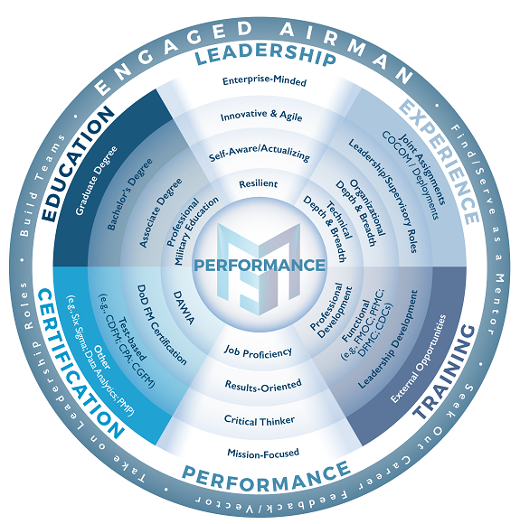
What’s Valued
FM Career Field and the Air Force
Engaged Airman
Find & serve as a mentor
Seek out career feedback
Take on leadership roles
Build teams
Values / Growth
Performance
Leadership
Experience
Training
Certifications (if applicable)
Education
Notes:
8
When looking a civilian’s record, there are many items you can utilize. Force Development Primer, Career Development Roadmaps, etc. However, each year the FM Development Team reviews and updates the “What’s Valued” slide as needed.
In the bullseye/center of the circle is performance which has to be the first measure of merit. Are you performing in your job.
Then if you look at the out rings, you see things we want everyone to aspire to—Being an ENGAGED AIRMAN, Find and Be a mentor to others, Seek out feedback/advice, take on leadership roles.
Next, are the fans—Leadership being at the top and performance being on the bottom. Within each fan, are items the civilian can individually work on or grow to help meet a focus area in that particular fan.
Important aspects to growing are gaining experience, obtaining education, seeking out appropriate training—both functional and enterprise, and finally certifications.
An employee and supervisor can sit down and go over this wheel to determine gaps and create an Individual Development Plan—which we will talk about later in this briefing.

Slide 9
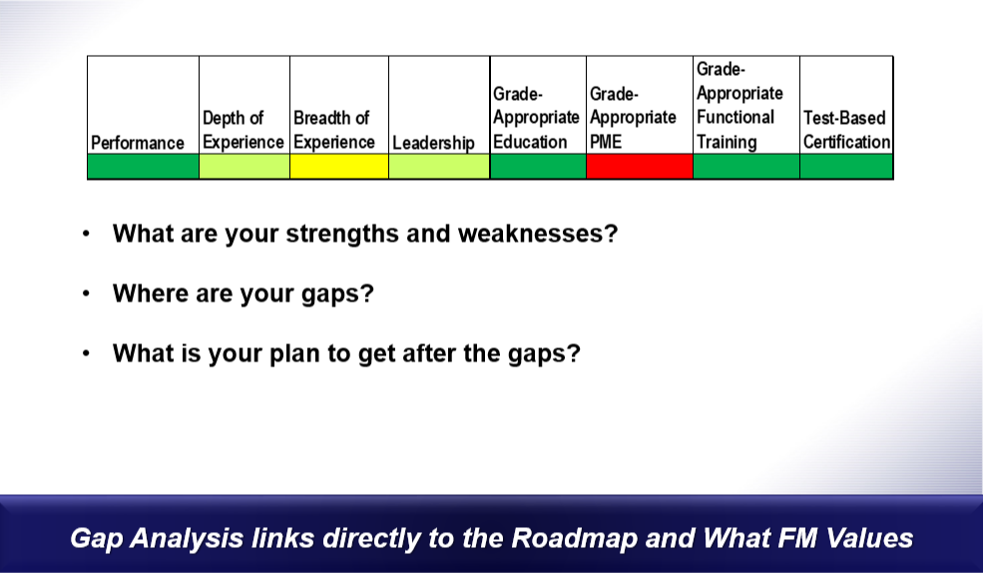
Assess Your Gaps
Do you See Potential Barriers?

Slide 10
AY23 CDE Portfolio
Basic Developmental Education (BDE)
Squadron Officers School (SOS) GS 9-12 120
Intermediate Developmental Education (IDE)
Air Command & Staff College (ACSC) In Residence GS 12-13 24*
ACSC On-Line Master's Program (ACSC-OLMP) GS 12-14 220
ACSC - Schriever Space Scholars (ACSC-SSS) GS 12-13 *
ACSC School of Advanced Nuclear Deterrence Studies (SANDS) GS 12-13 *
ACSC + School of Advanced Air and Space Studies (SAASS), GS 13 only *
Senior Developmental Education (SDE)
Air War College (AWC) GS 14-15 18*
Air War College - West Space Seminar (AWC-WSS) GS 14-15 *
College of Info & Cyberspace (CIC) GS 14-15 3
Defense Senior Leader Development Program (DSLDP) GS 14-15 12
Eisenhower School, Nat’l Security & Resource Strategy (ES) GS 14-15 5
Eisenhower School , Nat’l Security & Resource Strategy - Senior Acquisition Course (ES SAC) GS 14-15 14
National War College (NWC) GS 14-15 2
Academic / Fellowships
AF Legislative Fellows (LEGIS) GS 12-14 8
AF Nat’L Labs (AF NLTP) GS 12-15 4
Bachelor's Degree GS 07-15 11*
Civilian Associate’s Degree Program (CADP) All grades GS & FWS
Education w/ Industry (EWI) GS 11-13 30
Master's (In-Residence, Accredited University) GS 12-15 *
Master's (AFIT) GS 12-15 *
President's Management Council - Interagency Rotation Program (PMC-IRP) GS 13 12
RAND Fellowship GS 14-15 2
White House Leadership Development Program (WHLDP) GS 15 1
Leadership Seminars / Short Courses
Civilian Leadership Course (CLC) GS 14-15 120
Defense Civilian Emerging Leader Course (DCELP) GS 7-11 67
Enterprise Leadership Seminar (ELS) GS 15 80*
Enterprise Perspective Seminar (EPS) GS 15 *
Excellence in Government (EIG) GS 14-15 20
Executive Leadership Development Program (ELDP) GS 12-13 +Not offered in AY23+ 10
Leading Change & Innovation (LCI) GS 15 59
Leading Effectively Through Change (LETC) GS 14-15 240
Leading Strategically (LS) GS 15 *
Leading With Impact (LWI) GS 12-13 210
Nat’l & International Security Leadership Seminar (NISLS) GS 15 *
AF Organizational Leader Course (OLC) GS 11 500
Upgrading your Executive Leadership Approach (UEL) GS 15 59
Note: Courses with * share quotas within category
Number of AF wide Quotas is indicated in red
Notes:
The Academic/Fellowships category offers programs where participants either gain a degree or participate in a fellowship opportunity.
The Leadership Seminars/Short Courses category offers a variety of opportunities for those who are not looking for PME or a degree. Some of these courses are short (3 days, 1 week, etc) and some of them are experiential in nature.
You will notice a legend at the bottom left of the chart.
- If a program has a red “D” next to it, that means it is a DT-approved program and selections are approved at the functional DT level. The programs without a red “D” are the Boarded programs that meet the CDE Board.
If there is a green star next to the program, that is a program that was new to the portfolio in AY22. We look forward to seeing the benefits of these programs as they are implemented.
Lastly, if a program is highlighted in yellow, this means that it is open to our tactical-level employees.
As you can see in the blue bar across the bottom left, we filled 2,084 quotas in AY22! We look forward to providing developmental opportunities to more individuals in AY23!
CDE does not manage PME by DL (AU does)…see slide at end of briefing for DL info

Slide 11
Civilian Strategic Leader
Program (CSLP)
Systematic, open process to compete and fill AF command-equivalent positions at the GS-14/15 grade levels (GS-13s can now be promoted into DDIS positions)
  Develops civilians for challenging and critical leadership positions
  Provides fresh leadership perspectives to organizations
  64 positions (0301/0343 series)
  43 Installation level
  1 MAJCOM
  8 HAF level
  12 Joint
Must have a bachelor’s degree
Must have 12 months in current position
Must have supervisory experience
Requires mobility agreement
DT validates/endorses potential candidates to CSLP Selection Board
***Must apply through CDE Process***
*Note: Dual application process (USAJobs AND MyVector)

Slide 12

Civilian Short-Term Experiential Program
Eligibility
Permanent GS 11-14 (and equivalent)
Two years federal service as of 25 Feb 22
Member of one of the following career fields:
  Audit
  Financial Management
  Force Support
  Scientist & Engineer (1515 occ series only)
Individuals currently participating in or vectored for a developmental position are ineligible (e.g., Career Broadening, PAQ, etc.)
Additional Details
Projects are virtual or within the local commuting area; no TDY or PCS required
Projects last up to six months
Apply via MyVector
1 March-1 April 22
Program Benefits
Build enterprise leadership competencies
Enhance development of self, others, organizations, and ideas
Gain experience in a different role
Access senior leader mentorship
For More Information
See the Civilian Force Development home page on myPers or
Contact us by email at afpc.civiliandevelopment.cde@us.af.mil

Slide 13
Developmental Opportunities - CDE
Important Tips to Remember
The process is highly competitive at all levels
  Have a plan and begin preparing the package early
  KEY: Determine who will review and endorse package UPFRONT
Employee applies via MyVector - deadline 25 Feb 2022
  Employee selects endorsers and reviewers before package can be submitted; if not identified, package will not submit
  Resumes must be complete and IAW the FM Toolkit; blank/ incomplete resumes will not be scored
Supervisors: Review packages before endorsing as supervisor
  Review endorsement requirements for course and ensure employee selects correct endorsers
Endorsement deadline: 18 March 2022
  If required endorsement is not included (e.g., 2nd level GO/SES) AFPC will determine the package
NOTE: Understand your organization’s deadlines – these will be in advance of the AF CDE deadlines; late packages will not be accepted
System challenges exist – start early and reach out for help

Slide 14
AY23 Information:
Timeline
Civilian applicant window (MyVector).………. 18 Jan – 25 Feb
  Eligibility requirements must be met before the applicant window closes
  Check with your local Chain of Command for any organization-specific timelines
Civilian endorser review window..……………. 18 Jan - 18 Mar
Functional Development Team (DT) review…. 18 Apr & 10 May
DAF CDE / CSLP Selection Board...…………... Jul
AF/A1 review / approve selections………....... Aug
CDE / CSLP selections announced…………… Sep

Slide 15
AY23 Information:
CDE Changes
    Two years federal service; DT Chair may waive this requirement for short (3-5 day) courses
      This requirement completely waived for Organizational Leader Course (OLC)
    OCONUS personnel must PCS to CONUS location prior to long-term training
    ELDP removed from AY23 nomination cycle to eliminate backlog
    Bachelor’s / Master’s Degree Programs
        Online degrees allowed if offered at in-state tuition rates
        Eligible population increased to GS 07-15 and equivalent for Bachelor’s Program
    Federal Wage System (FWS) eligibility
      Bachelor’s Degree Program - GS 07-15 equivalent
      Master’s Degree Program - GS 12-15 equivalent
      OLC – only wage supervisors (WS) and wage leads (WL) may apply
    Non-Appropriated Fund (NAF) eligibility
      Civilian tuition assistance
      Leadership seminars and short courses (dependent on system access / support)

Slide 16
Lessons Learned
AY22 FM Civilian DT
  Gaps in “What FM Values” should be closed prior to applying for a CDE opportunity
  Resume in MyVector—refer to CDE Toolkit
    Don’t use the auto generated resume
    Remove ancillary training (Cyber Security, SAPR)
    Ensure you list your FM PME!
  Luke warm endorsement/Lack of stratification
  Weak goals
  Applicants should apply to more than one qualified program
  Not the right time in applicant’s career
Notes:
These are some of the reasons why the DT did not recommend an applicant for CDE this year. Ensuring your package strongly reinforces “What FM Values” and you’ve taken steps to close your gaps prior to applying for CDE will make your package more competitive.
In a number of cases, MyVector resumes were not complete or correct, and it is also crucial that you involve your leadership up front to ensure you know “who” should endorse your package, ensure that you have a strong endorsement, and your leadership stratifies you appropriately.
Some programs are extremely competitive; applying to more than one program may allow you to still be selected for CDE even if you aren’t chosen for your first preference.
Requesting the right opportunity at the right time is important. If you request one program and are not as competitive as the other applicants, you may not be vectored to an opportunity.
NEXT SLIDE

Slide 17
Who Is Your Development Team Representative
Air Staff / COCOM
MAJCOM Level
Center below MAJCOM
Civilian Development Team Advisory Committee (CDTAC): Sub-committee to Development Team (DT) that advocates GS-13 and below non-boarded programs
Civilian Development Team (DT): Most senior level committee that advocates GS-14/GS-15 (equiv grades) and all boarded programs

Slide 18
Resources
  myFMHub Civilian Opportunities CDE https://www.myfmcareer.hq.af.mil/index.cfm?event=civilian
  FM CDE Toolkit AY23 https://usaf.dps.mil/teams/fmhub/CivDev/SitePages/CDE.aspx
  MyPers Force Development site https://mypers.af.mil/app/categories/c/549/p/2
Notes:
These are some of the reasons why the DT did not recommend an applicant for CDE this year. Ensuring your package strongly reinforces “What FM Values” and you’ve taken steps to close your gaps prior to applying for CDE will make your package more competitive.
In a number of cases, MyVector resumes were not complete or correct, and it is also crucial that you involve your leadership up front to ensure you know “who” should endorse your package, ensure that you have a strong endorsement, and your leadership stratifies you appropriately.
Some programs are extremely competitive; applying to more than one program may allow you to still be selected for CDE even if you aren’t chosen for your first preference.
Requesting the right opportunity at the right time is important. If you request one program and are not as competitive as the other applicants, you may not be vectored to an opportunity.
NEXT SLIDE

Slide 19
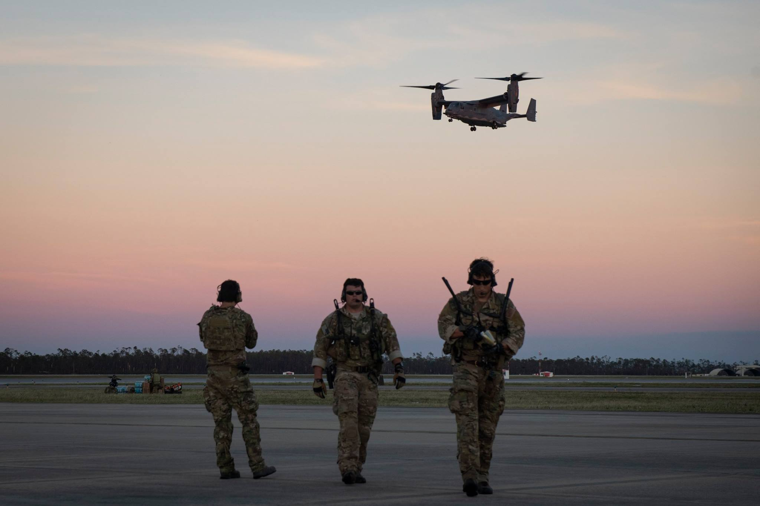
Questions?

